Slide 1
Topic:Historical perspectives of Management Principles
Dr. C. Vijaya Banu
Professor , School of Management
SASTRA Deemed University, Thanjavur – 613 401
vijayabanu@mba.sastra.edu

Slide 2
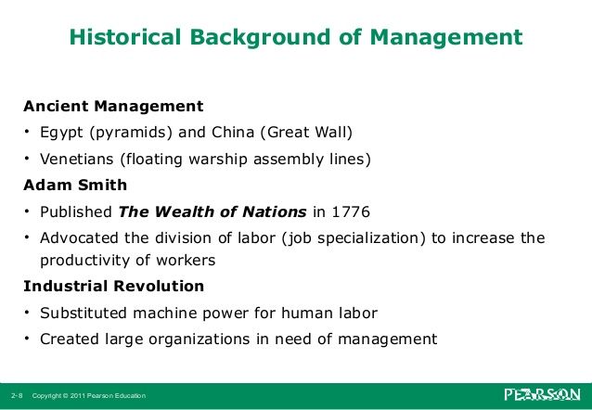

Slide 3
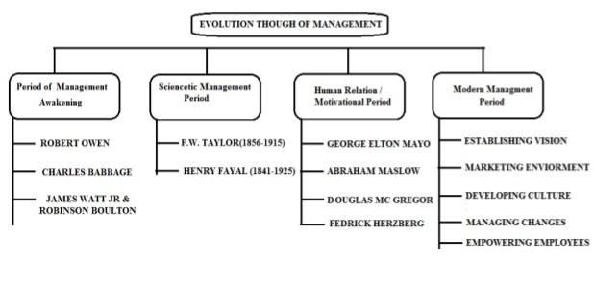
Evolution

Slide 4
Historical Background of Management
Ancient Management Egypt (pyramids) and China (Great Wall) Venetians (floating warship assembly lines) Adam Smith-Published The Wealth of Nations in 1776 Advocated the division of labor (job specialization) to increase the productivity of workers Industrial Revolution Substituted machine power for human labor Created large organizations in need of management

Slide 5
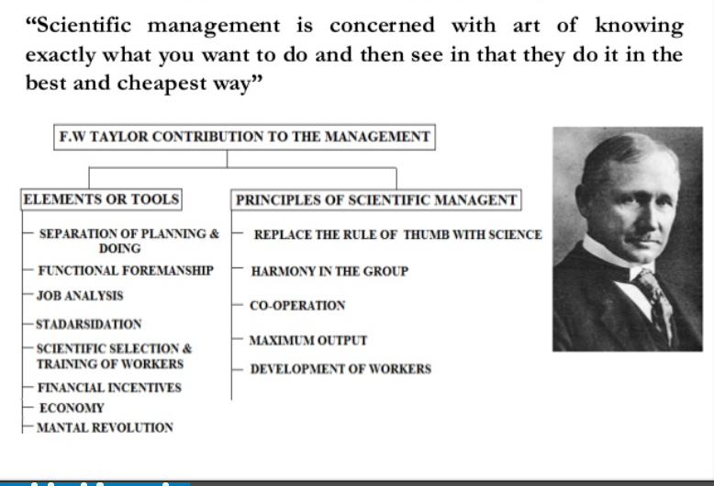
Scientific Management

Slide 6
Scientific Management -Tools
Tools
Separation of planning & doing
Functional Foremanship
Job Analysis Standardization
Scientific selection and training of workers
Financial Incentives
Economy Mental Revolution
Principles of Scientific Management
Replacing rule of thumb with science Harmony in group action
Co-operation Maximum output
Development of workers

Slide 7
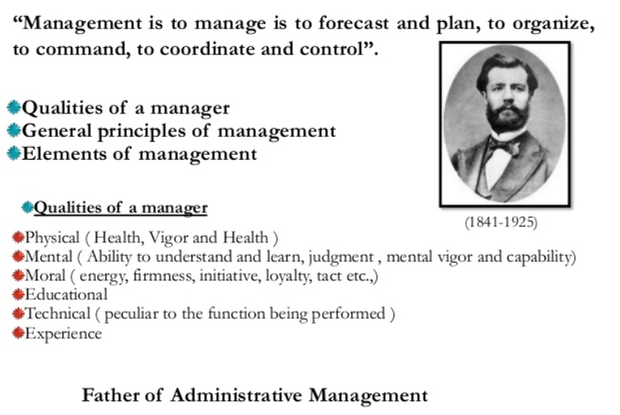
Henry Fayol

Slide 8
Henry Fayol’s 14 Principles
Source : OB/Management-11th-edn-by-Stephen-P-Robbins-Mary-Coulter

Slide 9
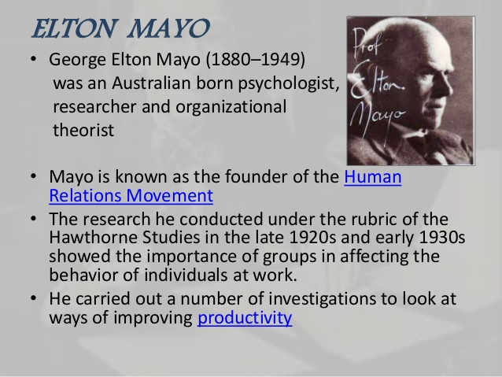
Hawthorne Experiment

Slide 10
Hawthorne Experiment Conclusions
Psychological Contract There is an unwritten understanding between the worker and employer regarding what is expected from them; Mayo called this the psychological contract.
Interest in Workers A worker’s motivation can be increased by showing an interest in them. Mayo classified studying the workers (through the experiments) as showing an interest in the workers.
Work is a Group Activity Work is a group activity, team work can increase a worker’s motivation as it allows people to form strong working relationships and increases trust between the workers. Work groups are created formally by the employer but also occur informally. Both informal and formal groups should be used to increase productivity as informal groups influence the worker’s habits and attitudes.
Social Aspect of Work Workers are motivated by the social aspect of work, as demonstrated by the female workers socialising during and outside work and the subsequent increase in motivation.
Recognise Workers Workers are motivated by recognition, security and a sense of belonging.
Communication The communication between workers and management influences workers’ morale and productivity. Workers are motivated through a good working relationship with management.

Slide 11
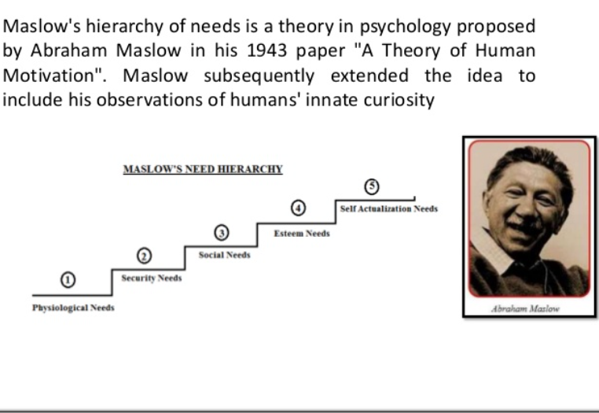
Maslow’s Need theory

Slide 12
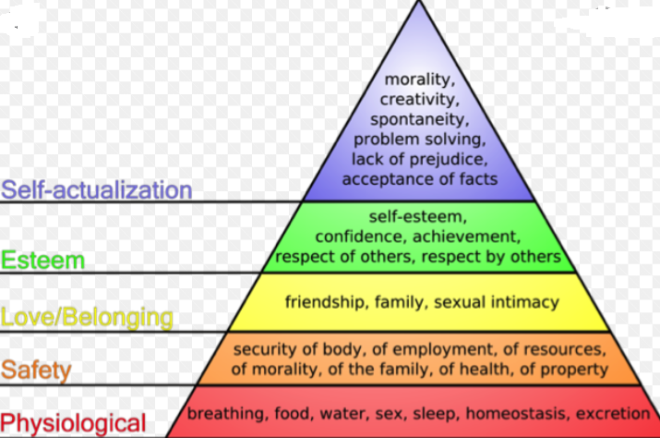
Maslow’s Need theory

Slide 13
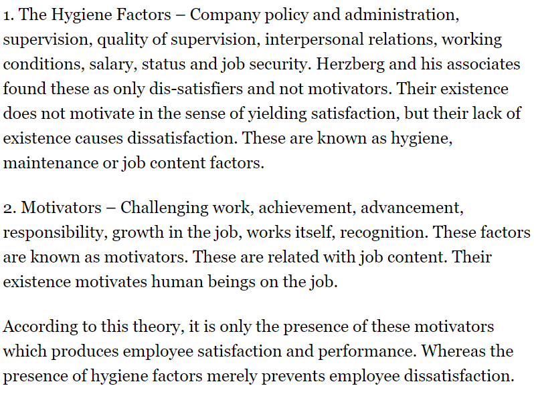
Herzberg theory

Slide 14
Herzberg theory

Slide 15
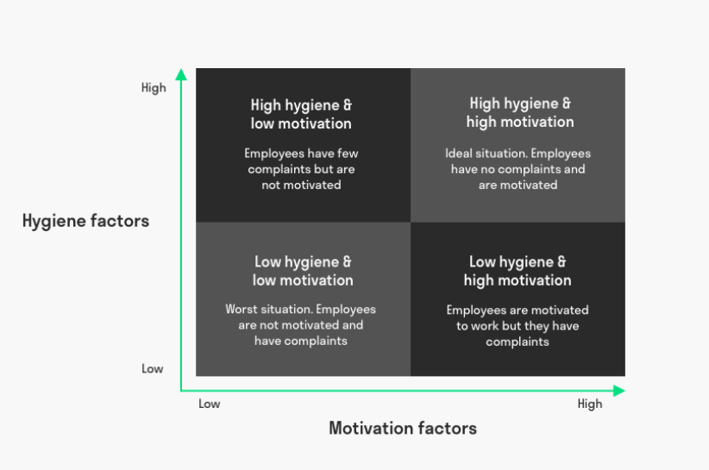
Herzberg theory

Slide 16
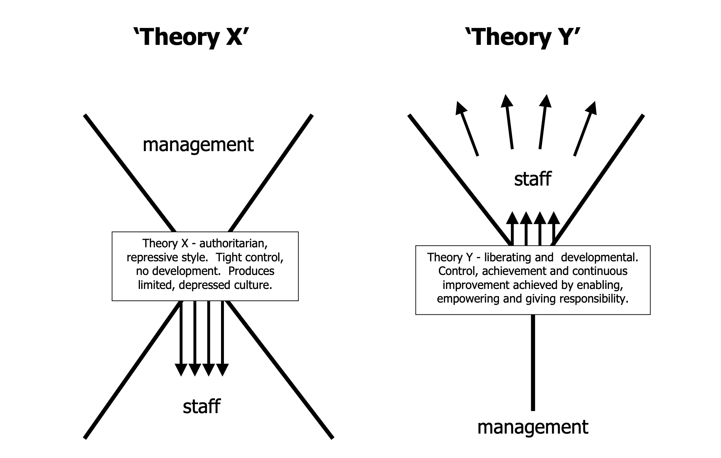
Douglas McGregor (MIT Sloan School of Management) in the 1950s,

Slide 17
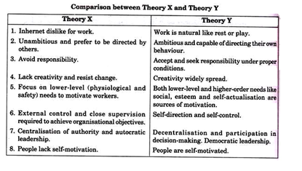

Slide 18
Universal Need for Management
Source : OB/Management-11th-edn-by-Stephen-P-Robbins-Mary-Coulter

Slide 21
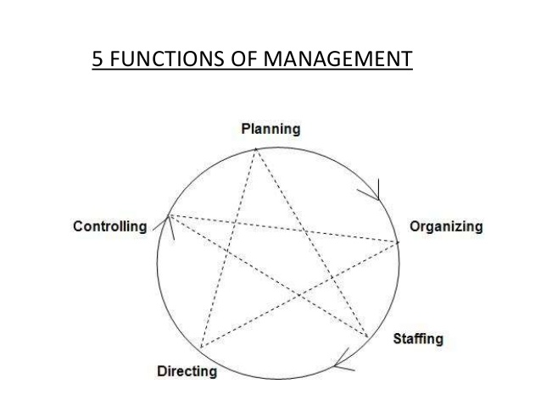
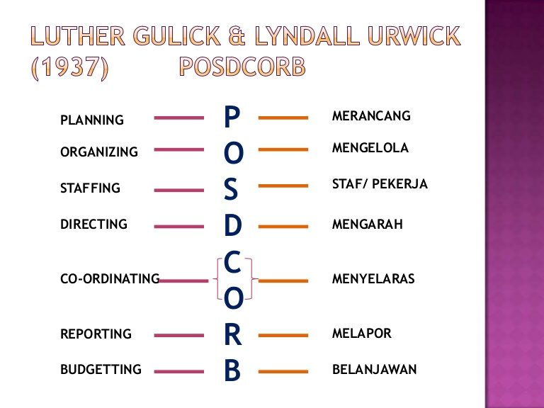

Slide 22
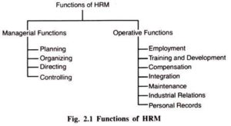

Slide 23
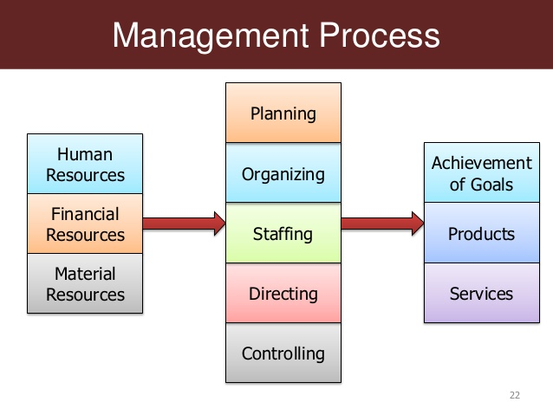

Slide 24
Early OB Advocates
Source : OB/Management-11th-edn-by-Stephen-P-Robbins-Mary-Coulter

Slide 26
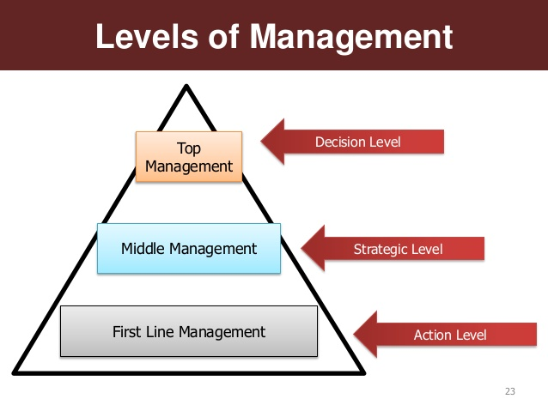

Slide 29
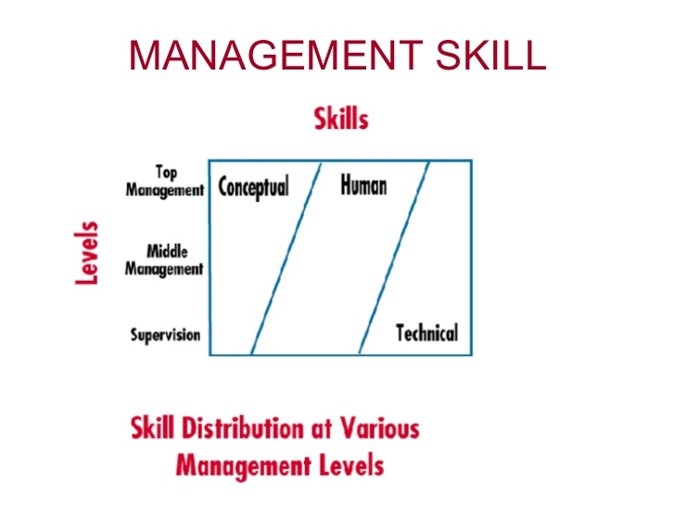

Slide 30
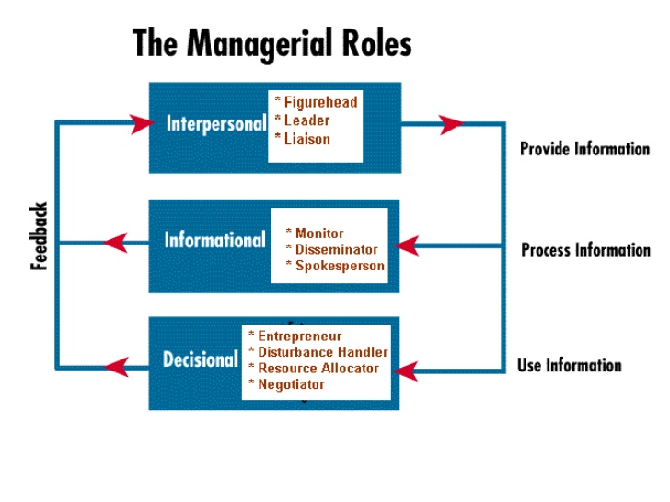

Slide 31
INTERPERSONAL
Role | Description | Identifiable Activity
Figurehead | Manager serves as an official representative of the organization or unit | Greeting visitors; signing legal documents
Leader | Manager guides and motivates staff and acts as a positive influence in the workplace | Staffing, training
Liaison | Manager interacts with peers and with people outside the organization to gain information | Acknowledging mail/email; serving on boards; performing activities that involve outsiders

Slide 32
INFORMATIONAL
Role | Description | Identifiable Activity
Monitor | Manager receives and collects information | Reading magazines and reports; maintaining personal contacts
Communication (Disseminator) | Manager distributes information within the organization | Holding meetings; making phone calls to relay information; email/memos
Spokesperson | Manager distributes information outside the organization | Holding board meetings; giving information to the media

Slide 33
DECISIONAL
Role | Description | Identifiable Activity
Entrepreneur | Manager initiates change | Organizing sessions to develop new programs; supervises design of projects
Disturbance Handler | Manager decides how conflicts between subordinates should be resolved | Steps in when an employee suddenly leaves or an important customer is lost
Resource Allocator | Manager decides how the organization will use its resources | Scheduling; requesting authorization; budgeting
Negotiator | Manager decides to negotiate major contracts with other organizations or individuals | Participating in union contract negotiations or in those with suppliers

